Slide 2


Towards Financial Inclusion (FI)
Using survey data to assess FI status of the Philippines
Sprint 1, Sept 2022
Rick Aaron Sta.Clara
Notes:
Image: https://oi-files-cng-prod.s3.amazonaws.com/asia.oxfam.org/s3fs-public/styles/full-width-670x335-2_1/public/OGB_120684_Ruth,%20Davos%202020,%20Inequality.jpg?itok=Dm-D9WIN

Slide 3
SPRINT TIMELINE
 | MONDAY | TUESDAY | WEDNESDAY | THURSDAY | FRIDAY | SATURDAY
Week 1 | Sprint Overview Pandas: Basic data wrangling techniques | Pandas: Advanced data wrangling techniques | Data visualization Introduction to Streamlit | Lab activity: Exploratory Data Analysis | Data storytelling Creating your own Streamlit web page Mentor-free day | Review of Week 1
Week 2 | Introduction to Machine Learning Clustering | Introduction to Linear Regression and Logistic Regression Mentor-free day | Introduction to deployments Deployment using Streamlit Cloud and Hugging Face Spaces | Sprint Project Prep Day 1 | Sprint Project Prep Day 2 | Sprint Presentation

Slide 4
DAY 8 AGENDA
RECAP
01
INTRODUCTION TO DEPLOYMENTS
02
INTRODUCTION TO GITHUB
03
INTRODUCTION TO STREAMLIT CLOUD AND HF SPACES
04
SPRINT OUTPUT BRIEF
05

Slide 5
01
RECAP

Slide 6
02
INTRODUCTION
TO
DEPLOYMENTS

Slide 7
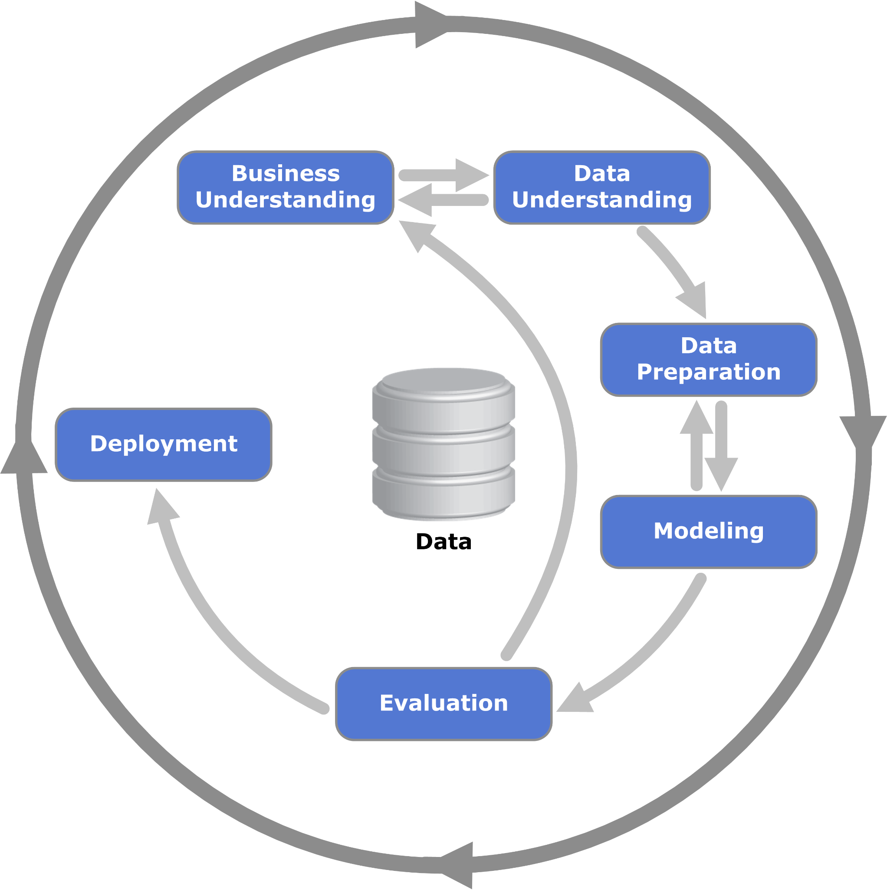
How do deployments fit in data science?
In our previous discussions, we learned about data wrangling and data visualization.
We moved on to building machine learning models out of our data.
Then, if we think our dashboard or machine learning model is good enough, then we can deploy it so others can consume what we have done!

Slide 8

Isn’t deployment a part of an engineer’s job?
For the most part, yes.
In a typical ML pipeline, those that deploy our data projects are usually software engineers. If we have a data mature team, then machine learning engineers might be the one who will see it to production.
Deployments can get complicated pretty fast as it involves tinkering with various infrastructures.
As data scientists, knowing how our model or dashboard is deployed can help us in making improvements in our data products.

Slide 9
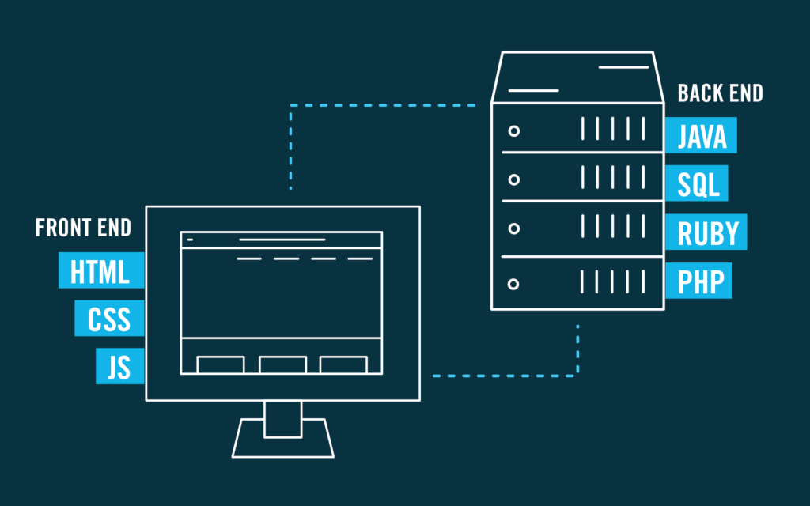
Creating a web application
When you want to “deploy” your dashboard or machine learning model to your stakeholders for consumption, you might be asked to create a web app. Note that creating a web app is usually done in two parts: (1) prototyping in your local (i.e. creating the components in your OWN computer and (2) deploying to production (i.e. deploying your code in a virtual machine so other people can access and use it).
Creating a web app is a process of creating various moving components which can be broadly categorized into two major parts: the front-end and the back-end.

Slide 10
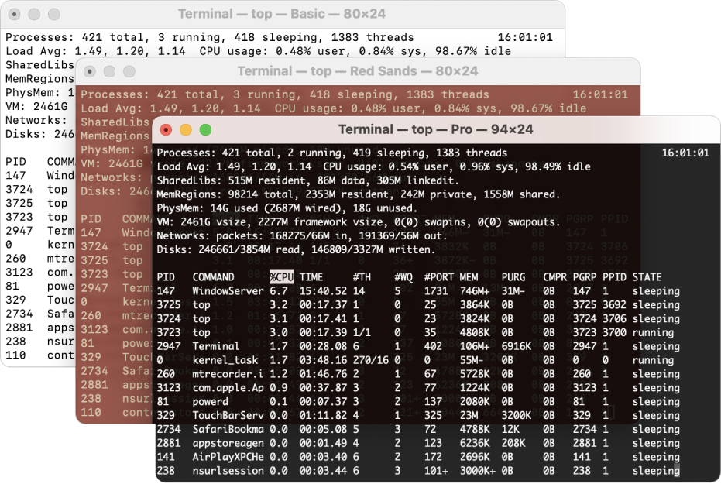
What tools should I know for prototyping and deployment to prod?
In prototyping a web app, you must be comfortable working with the following (knowing the basics is enough):
terminal
text editors (Sublime, PyCharm, VS Code)
Jupyter
In deploying to prod, you need to know all of the above plus the following:
deployment platform (Streamlit Cloud or Hugging Face Spaces)
deployment files (Procfile and .sh files)
git

Slide 11
03
INTRODUCTION
TO
GITHUB

Slide 12
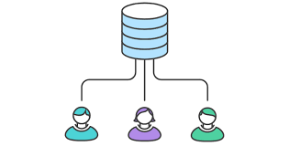
Before Git…
Say, we have three people working on a single code base: Person A, Person B and Person C.
Person A added some features in the code base. After adding the features, she sent her code to Person B via email to review her code. While Person B is reviewing the code, Person A found a bug in her code so she decided to change it. While all of these are happening, Person C is developing a whole new feature.
How would they merge their codes? Git is an answer to these complexities.

Slide 13

Git and GitHub
Git is a version control system that allows for streamlined collaboration in creating and modifying code bases. In data science and software engineering teams, version control systems allow us to keep track of all the changes in the code base. It makes creating and reviewing code much easier.
Note that Git is different from GitHub. Git is a version control system while GitHub is a cloud-based hosting service. Fun fact: Linus Torvalds, the creator of Linux, also created Git!

Slide 14
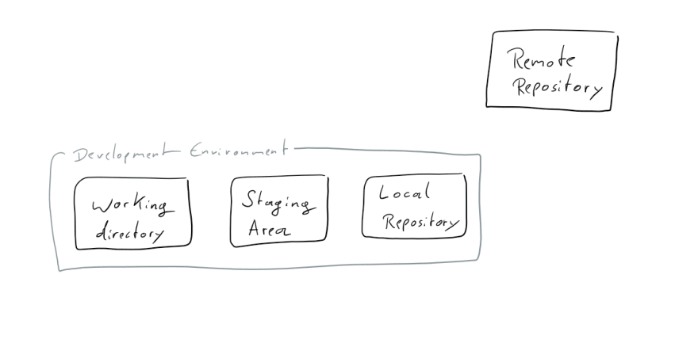
Basic git concepts

Slide 15
Basic git concepts
Remote repository is where the files are in a remote server that can be accessible by other people.
Local repository is a copy of the remote repository stored in your local machine.
Working directory can be treated as your “workbench”. This is where will you make some changes in your code and your data. If you think your changes are final, then you move those modified files to the staging area then commit it to the local repository.

Slide 16
Basic git concepts
Git has a concept called branch. Essentially, a branch is a version of your repository. The main branch is usually called either main or master.
During code development, we do not usually modify the main branch unless the changes we make are final. The usual process is as follows:
Branch out of main.
Make some changes in your branch.
Create a pull request to main (pull request = request to make some changes in the main branch).
Merge branch to main.

Slide 17
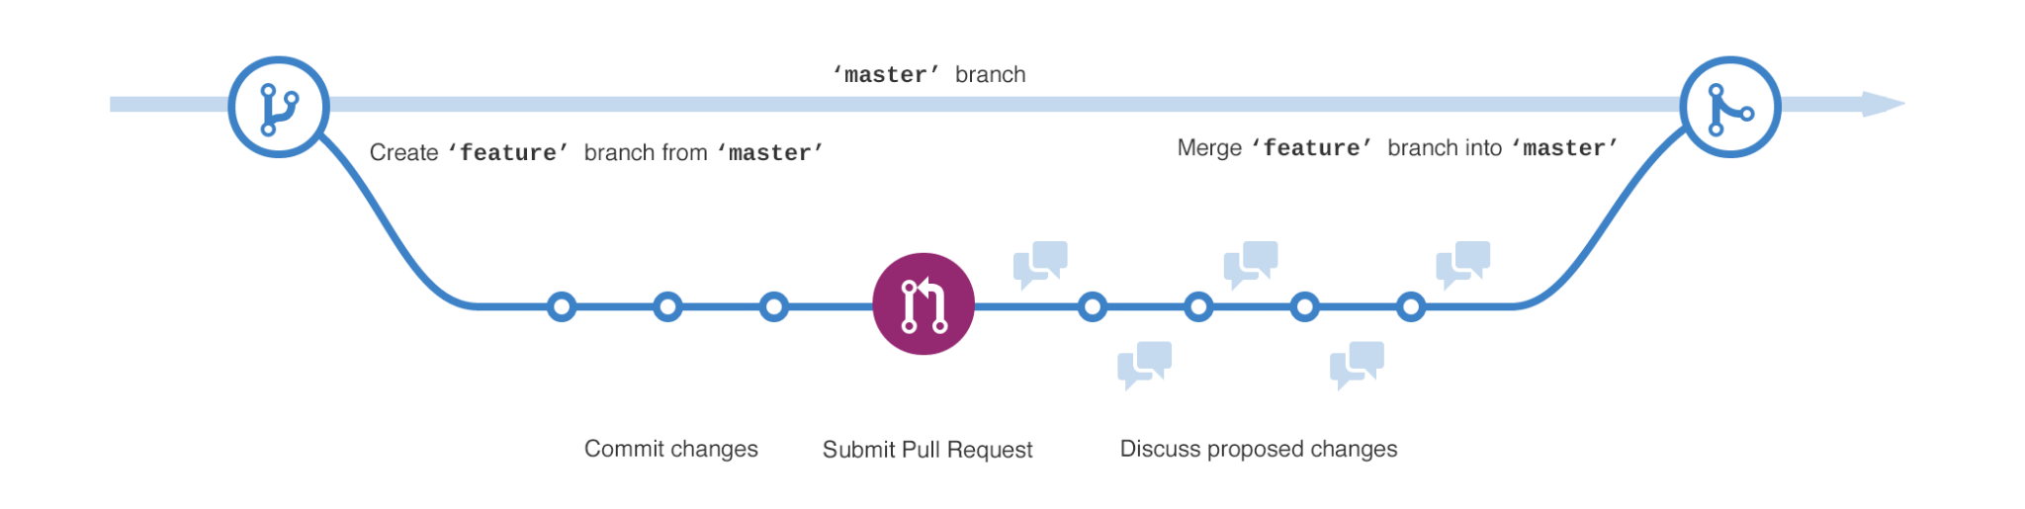
Basic git concepts

Slide 18
Basic Git workflows
Cloning
Updating the remote repo
Updating your local repo
Creating a pull request (PR)-based push

Slide 19
Cloning
To clone (i.e. create a copy of remote repository to your local machine), copy the link of the repository on GitHub.
Using your command prompt/CLI, select the directory where you will put the repository then run git clone <GitHub link here>.

Slide 20
git clone
To clone (i.e. create a copy of remote repository to your local machine), copy the link of the repository on GitHub.
Using your command prompt/CLI, select the directory where you will put the repository then run git clone <GitHub link here>.

Slide 21
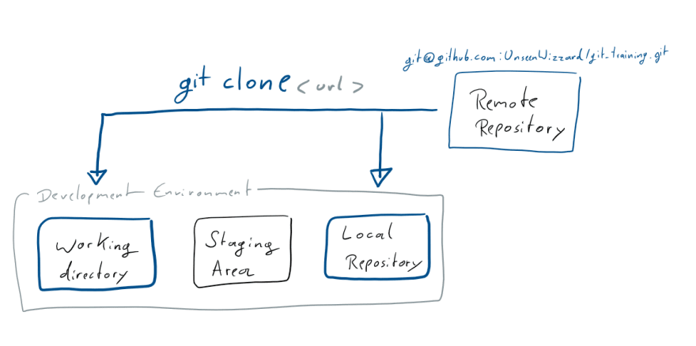
git clone

Slide 22
Updating the remote repo
To update the remote repo, do the following:
git add <modified_file>
git commit -m “<description>”
git push
To check whether the file was added to staging area, run git status.

Slide 23
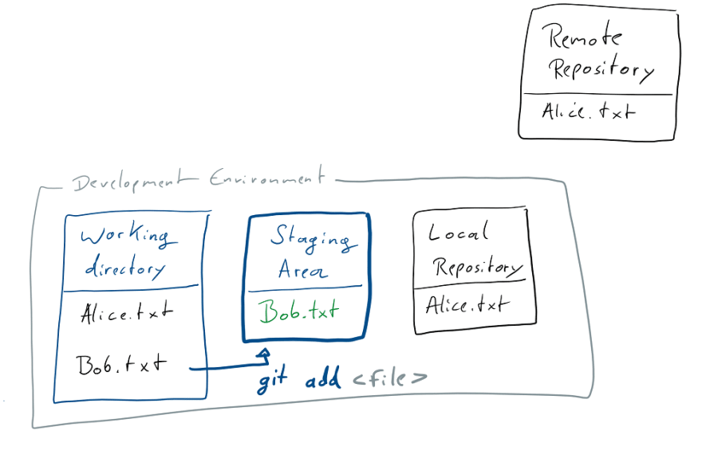
git add

Slide 24
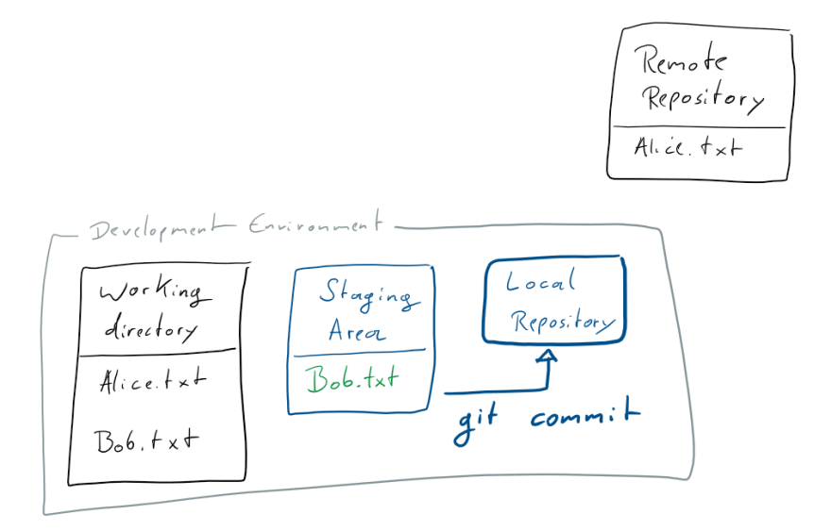
git commit

Slide 25
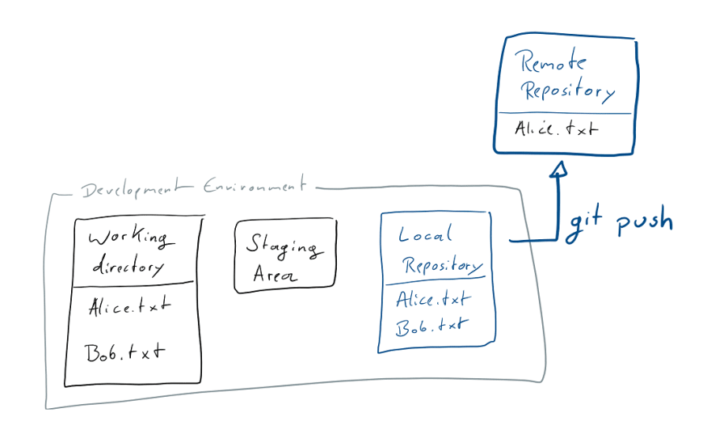
git push

Slide 26
Updating the local repo
To update the local repo, do the following:
git pull
If you wish to reset all the changes you made then update your repo, run the following:
git fetch --all
git reset --hard origin/<remote_branch>
git pull

Slide 27
Creating a PR-based push
To create a PR-based push:
Make sure that your local repository is updated.
Branch out of main using git checkout -b <name_of_branch> main.
Modify the files or add new files in your working directory. If you think the changes are final, move the files to the staging area then push it to remote.
You can repeat step 3 as long as you want until you end up with a branch that is final.
In GitHub, create a pull request. Wait for the approval of other members (in our case, the task leads).
Once done, merge your files to main.

Slide 28
Configuring credentials
To see your current credentials, type git config --list.
To change your email and name, simply type the following:
git config --global user.name “<input your username here>”
git config --global user.email “<input your email here>”

Slide 29
Generating Personal Access Token (PAT)
When you push some code to your repo from your local for the first time, Git will ask for your username and password. Note that password refers to the Personal Access Token (PAT). This is an additional security Git is enforcing now.
To generate PAT:
Got to github.com. Proceed to Settings > Developer settings > Personal access tokens > Generate new token > Input note > Check appropriate permissions (check all for now).
Copy the token to your terminal when Git asks for password. Do not share this!
Git will not ask again for password once you do another push.

Slide 30
Notes
There are a lot of nuances in using Git. You may research on your own as well.
A lot of times, people get frustrated because of the tediousness of using Git. However, its usefulness shines when we collaborate with others in coding. As paradoxical as it may sound, its tediousness allows us to streamline our development processes in the long run.
You may also look into the following:
initializing a Git folder via git init
resolving file conflicts (usually, you only need to follow what Git says)
checking out previous commit via commit code using git checkout <commit-code>
deleting a branch via git branch -d <brach>
... and so much more!

Slide 31
Try this on your own!
Sign in to your GitHub account.
Create a test repository.
Clone the repository.
Add sample .txt files in GitHub then update your local repository.
Create .txt file in your local repository then push it to remote.
Create another .txt file in a separate branch then create a pull request.

Slide 32
References
To learn more about Git in detail, visit the following link: https://dev.to/unseenwizzard/learn-git-concepts-not-commands-4gjc.

Slide 33
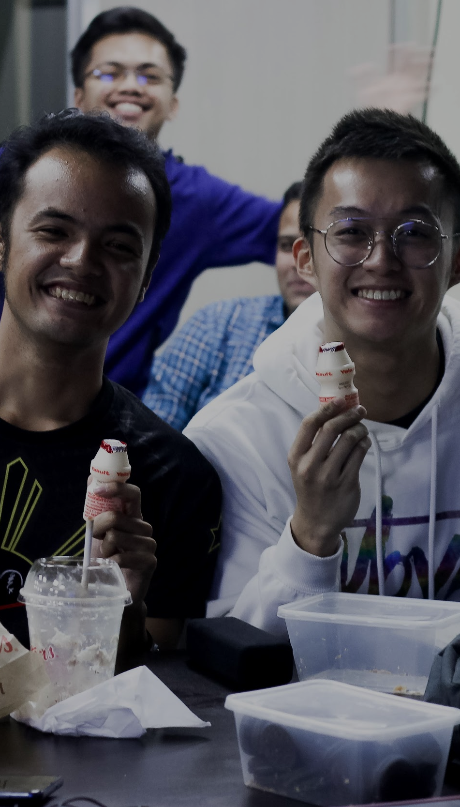






BREAK TIME ⏰
Mamma Mia Soundtrack
by TT Club
Be back by 07:10 PM

Slide 34
04
INTRODUCTION
TO
STREAMLIT CLOUD AND HUGGING FACE SPACES

Slide 35
Configuring access to Streamlit Cloud
Head to https://streamlit.io/cloud.
Sign up for an account.
Input your details. Please connect your GitHub as well.
Wait. Streamlit Cloud sometimes ask people to wait for a few days before receiving their invite.
Let the deployment begin!

Slide 36
What do I need for Streamlit Cloud deployment?
Setup a GitHub repo for your web app. In this step, please do not use generic names like “Sprint 1 - Group 2 Web App”. You will eventually share this to everyone as part of your portfolio so please name your app appropriately.
Ready your files. Usually, we prepare our requirements.txt, app.py, data and other media. If you will use photos in designing your web app, please compile it in one folder.
Make sure your app is running in your local. Once your app is running OK in your local, make sure your listed modules in requirements.txt match your environment modules so you will be sure it will run appropriately upon deployment.
Deploy your app in Streamlit Cloud. You will need to reconfigure the following: (1) repo location in GitHub, (2) branch and (3) main file path (usually, app.py or main.py).
If it fails, always READ what the error will say. It should point you to the right direction in identifying your bugs.

Slide 37
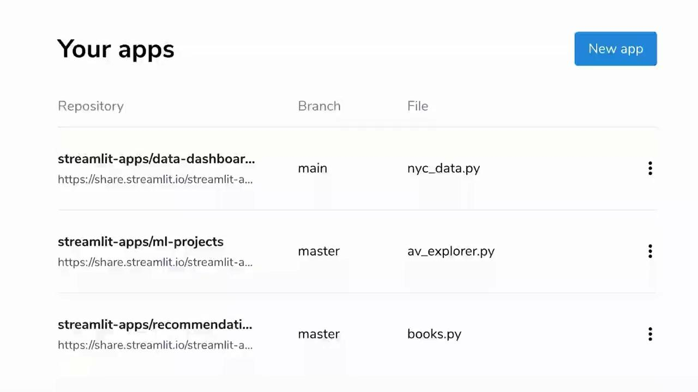
How do I actually deploy in Streamlit Cloud?

Slide 38
Configuring access to Hugging Face Spaces
Head to https://huggingface.co/.
Sign up for an account.
Input your details. Please connect your GitHub..
Confirmation email will be sent to your account. Accept and log in to Hugging Face.
Now, head to https://huggingface.co/spaces and let the deployment begin!

Slide 39
What do I need for Hugging Face Spaces deployment?
Setup a repo in Hugging Face Spaces. In this step, please do not use generic names like “Sprint 1 - Group 2 Web App”. You will eventually share this to everyone as part of your portfolio so please name your app appropriately.
Clone the repo in your local machine.
Ready your files. Usually, we prepare our requirements.txt, app.py, data and other media. If you will use photos in designing your web app, please compile it in one folder.
Make sure your app is running in your local. Once your app is running OK in your local, make sure your listed modules in requirements.txt match your environment modules so you will be sure it will run appropriately upon deployment.
Install git-lfs. To upload large files (>10MB), go to https://docs.github.com/en/repositories/working-with-files/managing-large-files/installing-git-large-file-storage.
Push your files to deploy your app.
Run git lfs install to initialize git-lfs.
Track large files by running git lfs track “*.csv” (our file is 30+ MB which is >10MB so we need this step)
Run git add .gitattributes
Run git add .
Run git commit -m “<your_message>” then do git push
If it fails, always READ what the error will say. It should point you to the right direction in identifying your bugs.

Slide 40
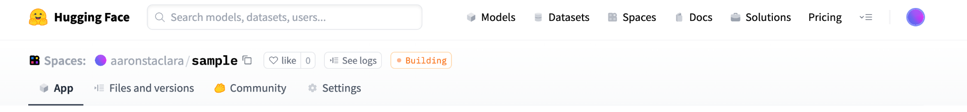
What do I need for Hugging Face Spaces deployment?
When you deploy your app, you should see Hugging Face Spaces displaying the following:
Wait for a few mins and you will see the Building become Running. Ta-da, you can now share your app! :D

Slide 41
LET’S CODE!
This is going to be a code-along session. If you can’t follow, feel free to open your mic and interrupt. You may also ask your mentors for help. Again, encountering errors is natural. 😁

Slide 42
ACTIVITY. In breakout rooms, explore deploying either via Streamlit Cloud or via Hugging Face Spaces. You can use the template .py files or you may use your own Streamlit files.
Please ask your mentor for installation issues. Enjoy! 😁
Allotted time: 1 hour
Notes:
http://mathcenter.oxford.emory.edu/site/math117/shapeCenterAndSpread/

Slide 43
05
SPRINT OUTPUT BRIEF

Slide 44
Sprint Output Brief
In the next 2 days, you will be able to work on your own for your sprint output. Here are the guidelines for your output:
Using the Global Findex 2017 Data, (1) assess the FI status of the Philippines and (2) recommend ACTIONABLE steps we can take towards financial inclusion. You may use the National Strategy for Financial Inclusion 2022-2028 of BSP for inspiration in tackling the dataset.
Expected outputs are: (1) pitch deck and (2) Streamlit.
Pitch deck should be at maximum 20 slides (recommended). Keep your presentation within 8 minutes. Shorter, better.
Streamlit output should be deployed and can be accessible by anyone.
Presentation will be graded based on the following::
data storytelling
data insights
social impact
Note that it is better if you can present 2-3 good actionable insights than presenting a LOT of insights that are not actionable and without value.
As always, collaborate with your groupmates and ask for guidance from your mentors and instructor. Enjoy! 😁

Slide 45
Consultation
Tomorrow is our consultation day. Together with your mentors, we can discuss your proposed topic and pick apart the details of your outputs. Each group will have a maximum of 45 min consultation.
Guide questions:
What is your topic?
What narrative will you follow?
What data will you need? How will you present it?
What insights do you hope to get? What action will you recommend?

Slide 46
TAKE-HOME READING:
Deployment as a Critical Business Data Science Discipline
by Thomas Davenport and Katie Malone
Ask:
Why is deployment skills essential?
Notes:
http://mathcenter.oxford.emory.edu/site/math117/shapeCenterAndSpread/

Slide 47
What’s next? 😎
Sharpen your data wrangling and data visualization skills. You will spend most of your time here more than machine learning. 🤪
Before diving deeper into ML, refresh your statistics. Fundamentally, as you might have noticed, machine learning is statistics. Sharp stats skills will also make you understand data at a deeper level.
Focus on doing project-based learning. It’s easier to retain skills that are gained from actually doing something than just learning how to do it. Expand your portfolio. Use GitHub, Streamlit, Hugging Face Spaces for deployment.
Simple > complex. Focus on solving problems using simpler methods than implementing complex models (like deep learning). In business or social impact space, it’s easier to get the buy-in of people when you can solve a problem in a simple manner and in a way that people can understand.
Impact > tools. Focus on creating impacts. Learn more data science tools and techniques but always treat it as a MEANS to solve a problem.
For people shifting into data science from a completely different background (like me), it might be helpful to treat DS as a way to make you better in your respective domains. Working in banking? Data science will make you better in credit! Working in engineering? Data science will make you a better engineer!
Enjoy learning. There is so much to learn about data science and machine learning!
Congratulations for finishing Sprint 1 lectures!

Slide 48
End of Sprint 1 Day 8
Any questions?

